Slide 1
CS390/CS6444: Big Data and Analytics
Summer 2021
Stephen H. Kaisler, D.Sc.
Lecture 0 – Administrivia
Stay Safe and Healthy

Slide 2

Contact Me
Adjunct Prof. Stephen H. Kaisler, D.Sc.
H: 301-498-4244
C: 240-593-0980
email: skaisler1@comcast.net
skaisler@gwu.edu
It is best to contact me via email during the day as I may not always have access to my cell phone.
You may leave a voice mail and I will try to call you back at the
earliest opportunity.
Teachers open the door.
You enter by yourself.
- Chinese Proverb –
CSCI 6444-10: Big Data and Analytics

Slide 3
Purpose
This course is an introductory course that will cover a lot of topics in Big Data and Analytics.
The objectives are:
  To introduce students to some of the concepts, issues and challenges in dealing with Big Data
  To examine the types of analytics and work with a few of the tools to process some relatively Big Data sets.
  To understand the type of advanced analytics beyond simple statistical analysis, data mining, and statistical machine learning which address complex problems facing business, society, science and engineering today.
  To describe the roles of data scientist and analytic scientist
  To practice some of the techniques through class projects.

Slide 4
Class Ground Rules - I
DDue to the COVID-19 pandemic, this class will be held entirely online. That means we need to set a few ground rules:
  I expect you to turn your camera on, even when you are not speaking. This class is highly dependent on your participation and being visibly present is part of it. If you cannot be visibly present, please write me a detailed explanation of the reason/s behind it.
  Please ask questions and make comments! by either raising your hand or using the Chat feature to indicate you want to ask a question.
  There will be breaks during class, similar to regular in-person classes. Try to avoid eating and other distractions during class.
CSCI 6444-10: Big Data and Analytics

Slide 5
Class Ground Rules - II
Other rules that should be obvious:
  Please connect from a quite environment that is conducive to learning. That excludes the supermarket, bus station, etc.
  Please dress appropriately for a traditional, face-to-face class.
  Please mute yourself when the instructor or other students are speaking, so as to reduce background noise. You can unmute yourself when it’s your turn to speak.
  While our class is in session, try not to use other tools or technologies so as to avoid unnecessary distractions. Please also refrain from chatting with people who are not in our class. When students engage in non-course-related communication during class, it is evident on screen and can be distracting to everyone in the class.
  Do not share our course Webex link and password with individuals who are not in our class.
  Do not share the recordings with people outside of our class.
CS3907/CSCI 6444: Big Data and Analytics
0-<number>

Slide 6
Course Requirements
This course consists of a term paper and several class projects.
1. Class Projects 65%
I. 25%
II. 40%
2. Term Paper 35%
Total 100%
There is no Final Exam as I want to use the 9th week for lecture.
Prerequisites: Programming and Data structures, Discrete Math, and a basic knowledge of ideas in abstraction, algorithms, etc.
  You will be programming in R; you should have had at least one programming course (preferably Java)
CSCI 6444-10: Big Data and Analytics

Slide 7
Textbooks
Required:
Rampolla, M.L. 2014. A Short Guide to Writing in History, 9th Ed. St. Martin’s Press 0312403577 or later
https://www.amazon.com/Pocket-Guide-Writing-History/dp/1319113028 - about $33 new, but there may be used versions.
Optional:
Data Science Books (posted to Blackboard)
R Books (posted to Blackboard)
Note: Rampolla’s book contains the rules for writing good term papers. I have used it for over 17 years through various editions. When I grade your term papers for spelling, usage, structure, etc., I will be using Rampolla as the key reference. So, I strongly recommend that you buy this book and read it. There is NO excuse for a poorly written paper at the Graduate Level!!
CSCI 6444-10: Big Data and Analytics

Slide 8
Class Notes
There will be class handouts provided every week. These will be posted to the class Blackboard site.
  The class notes will serve as an outline, but I will provide additional material during the lectures.
The final exam will be drawn from the class notes and the lectures. It will be on Blackboard.
It is incumbent upon you to attend every lecture (unless you are ill or on travel for your job) or to obtain class notes from someone who was virtually present (and, hopefully, awake and not surfing the net).
The additional books on Blackboard are supplemental to the lectures. You should read for absorption and understanding, not for regurgitation.
CSCI 3907-80/CSCI 6444-10: Big Data and Analytics

Slide 9
Term Papers
Term Papers
If English is NOT your primary language (or, even if it is), I encourage you to make use of the GW Writing Center, http://www.gwu.edu/~gwriter/. You should be able to contact them online for assistance and webex to talk to them.
I have posted the term paper requirements on Blackboard. Read them and adhere to them. I grade strictly to these requirements.
Submit to me two short paragraphs on the topic you choose for your term paper by lecture 4.
Begin your term paper early – time flies quickly!
You must use Rampolla as your guide. Points are subtracted for errors where guidance was provided by Rampolla.
CS3907/CSCI 6444: Big Data and Analytics

Slide 10
Course Policy
It is expected that you will work on your term papers individually.
It is appropriate, and a good idea, to discuss the ideas in your term paper with other students, but the work you turn in must be your own.
Read the GWU Academic Integrity Policy!!
CSCI 3907-80/CSCI 6444-10: Big Data and Analytics

Slide 11
Course Credit Policy
Average minimum amount of out-of-class or independent learning expected per week:
In a 14-week semester, including exam week, students are expected to spend a minimum of 100 minutes of out-of-class work for every 50 minutes of direct instruction, for a minimum total of 2.5 hours a week.
A 3-credit course includes ~2.5 hours of direct instruction and a minimum of 5 hours of independent learning, or 7.5 hours per week.
More information about GW’s credit hour policy can be found at: provost.gwu.edu/policies- forms (webpage); or provost.gwu.edu/files/downloads/Resources/Assignment-Credit-Hours-7-2016.pdf
CS3907/CSCI 6444: Big Data and Analytics

Slide 12
Class Projects - I
What we have to learn to do we learn by doing.
— Aristotle, Ethica Nicomachea II (ca. 325 B.C)
The bulk of the grade for this course will consist of several class projects using R.
Working in teams of 2 people, you will learn how to process big data sets from several analytic perspectives.
I will assign the teams arbitrarily before the first class and set up groups in Blackboard.
  Due to the idiosyncrasies of Blackboard, you will be paired with someone at your level as undergraduates and graduates cannot be mixed due to separate courses.
The team will be graded on their group results. Therefore, it is up to the team to make sure everyone does his or her fair share.
Do NOT ask me to resolve team conflicts or referee team disputes. As undergraduate/graduate students, you will need to get along for a semester in order to achieve a common goal.
CSCI 3907-80/CSCI 6444-10: Big Data and Analytics

Slide 13
Class Projects - II
The class projects will require substantial time outside of the class room.
Feel free to use all available hours not in class itself or working on the term paper to work on the class projects. Sleeping and eating are optional!!
The class projects are described in a separate handouts.
Why these projects?
I have taught computer science for 42 years. It is my experience that, today, most computer science students do not really understand the material without hands-on experience.
I feel as a Computer Science Graduate Student you should be able to demonstrate not only mastery of the conceptual material but the practical application of that material to real problems.
CSCI 3907-80/CSCI 6444-10: Big Data and Analytics

Slide 14
Syllabus
Week Topic
1 Introduction; Administrivia; Basic Concepts;
Term Paper Requirements;
1st Class Project; Some R to Get Started
2 Graph Analytics (using R); See R in Action by Kabacoff (Blackboard)
3 Introduction to Analytics; Descriptive and Predictive Analytics w/ R
4 Text Analytics w/ R
5 No SQL Databases: MongoDB;
6 Introduction to Hadoop and MapReduce; Spark/Scala
7 Graph Databases, Some Social Network Analysis
8 Advanced Analytics
9 Natural Language Processing; Term Paper due by COB
10 Big Data and Analytics: Issues and Challenges
See Kaisler, Armour, Espinosa, Money papers
Project #2 due by COB
CSCI 3907-80/CSCI 6444-10: Big Data and Analytics

Slide 15
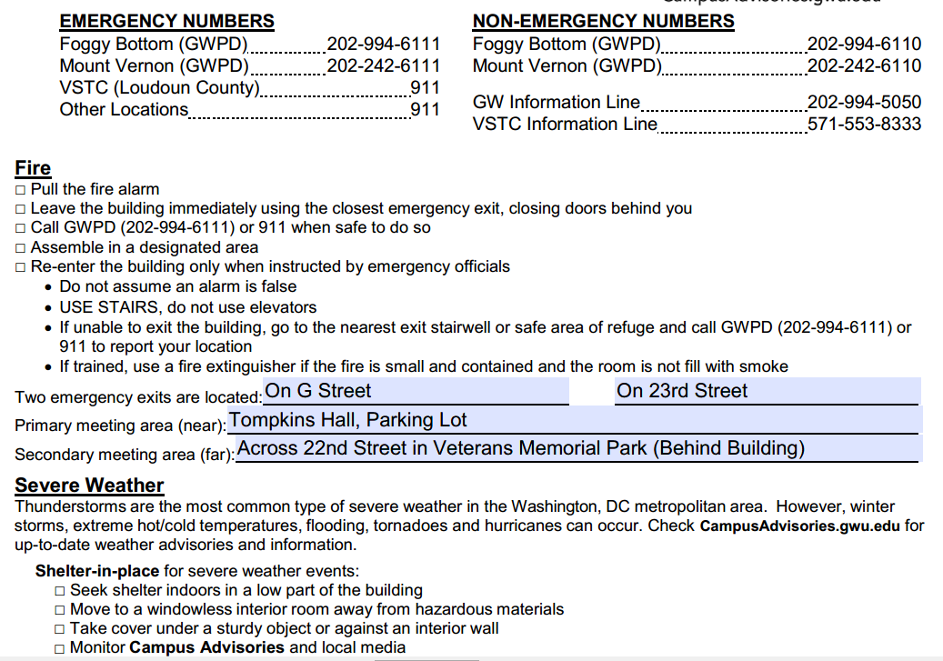
Emergency Preparedness Information
CSCI 3907-80/CSCI 6444-10: Big Data and Analytics

Slide 16

Emergency Preparedness Information
CSCI 3907-80/CSCI 6444-10: Big Data and Analytics

Slide 17
Some Readings
S. Kaisler, F. Armour, A. Espinosa, and W. Money. 2013. “Big Data: Issues and Challenges Moving Forward”, 46th Hawaii International Conference on System Sciences, Grand Wailea, Maui, HI
S.Kaisler, F. Armour, A. Espinosa, and W. Money. 2014. “Advanced Analytics: Issues and Challenges”, 47th Hawaii International Conference on System Sciences, Hilton Waikoloa, Big Island, HI
S. Kaisler, F. Armour, W. Money, and A. Espinosa. 2014. “Big Data: Issues and Challenges”, Encyclopedia of Science and Technology, 3rd Edition, IGI Global.
S. Kaisler, F. Armour, A. Espinosa, and W. Money. 2014. “Advanced Analytics: Issues and Challenges”, Encyclopedia of Science and Technology, 3rd Edition, IGI Global.
CSCI 3907-80/CSCI 6444-10: Big Data and Analytics

